Slide 1
Cilium SRv6 Lab: A Pathway to Cloud Native SP Network Services
Bruce McDougall
Nicolas Michel
Nov 2024
Notes:
Instructions:
FOR NEW SLIDES, USE “BLUE THEME 2015 16x9” MASTER SLIDES – Click New Slide button on toolbar (Home menu). Right click any slide thumbnail at far left to access available slide layouts)
Insert presentation details - speaker, title, date and architecture or solution
Before building your presentation, identify what your key topics will be, along with:
The value it brings to the customer
b) The technical aspect the SEs need to understand
c) Any cautions or restrictions
d) The relevant points for each topic SEs need to be clear on
e) How this process or feature is different from previous iterations, if appropriate
f) In your narration, always explain WHY the information is important AND bridge one topic to the next to demonstrate how it all fits together

Slide 2
Intro: Cilium and eBPF (15 min)
Lab 1 – dCloud, Containerlab, XRd, Ansible (10 min)
Lab 2 – K8s Fundamentals, Deploy K8s Cluster (15 min)
Lab 3 – Cilium SRv6 L3VPN (15 min)
Lab 4 – ISIS Redistribution into the Core (10 min)
Conclusion: eBPF on Everything – IoeBPFT (15 min)

Slide 3


The Most Important Place in the Network
Cisco’s historical Air-Gap
Someone Else’s Network
Cisco’s Network
Apps
Apps
NIC
Apps
Servers hosting applications/workloads
ToR, PE,
etc.

Slide 4



Isovalent Closes the Host Networking Gap
With Isovalent Cisco can now:
Own the DC Fabric
Own the Virtualized/Containerized Host Stack
Own the Network Policy, Security, and Visibility Framework…E2E
Own the Conversation with NetEng, NetSec, DevOps/SRE, and Application Owners and Developers

Slide 5













Some Logos
https://cilium.io/adopters/

Slide 6
CNI – K8s Container Network Interface
Decoupling of Control (Cilium) and Forwarding Planes (eBPF)
Programmatic interfaces
Workload Dataplane: routing, segmentation/overlays, access control, FW, LB, NAT
Host running containers
Direct Mode
Overlay / Tunnel Mode
(VXLAN, Geneve, SRv6*)

Slide 7

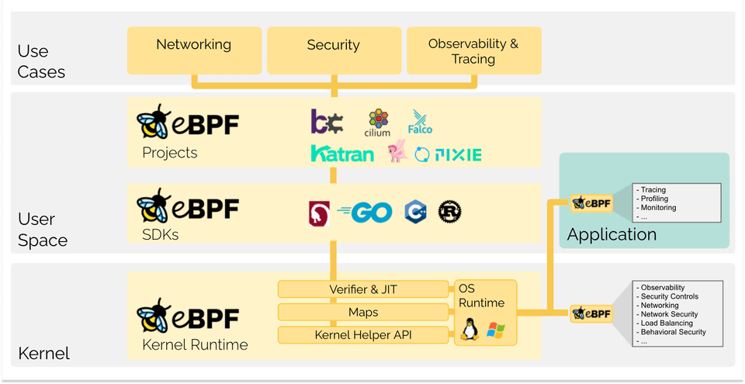
eBPF is a revolutionary technology that can run sandboxed programs in a privileged context such as the OS kernel. It is used to safely and efficiently extend the capabilities of the kernel without requiring to change kernel source code or load kernel modules.
Has its roots in Software Defined Networking

Slide 8
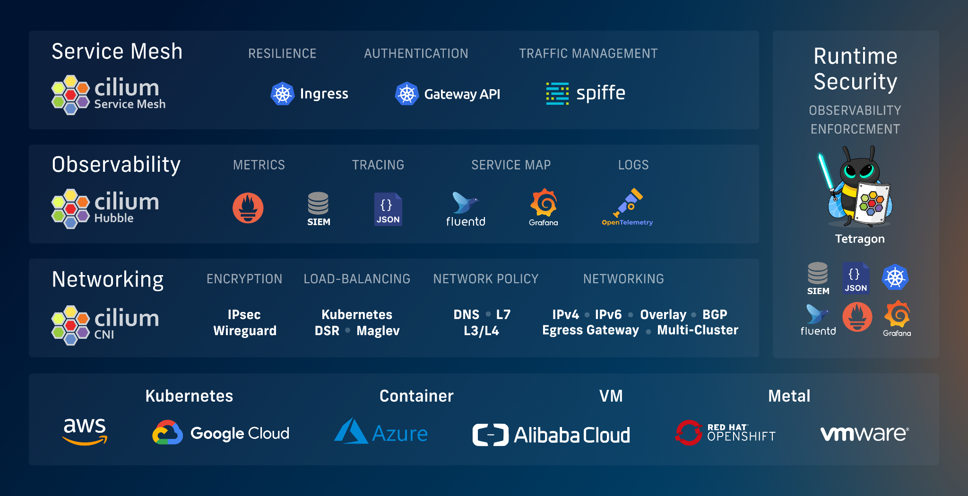
Cilium Enterprise:
One Solution For Your Cloud Native Journey

Slide 9
Intro: Cilium and eBPF
Lab 1 – dCloud, Containerlab, XRd, Ansible
Lab 2 – K8s Fundamentals, Deploy K8s Cluster
Lab 3 – Cilium SRv6 L3VPN
Lab 4 – ISIS Redistribution into the Core
Conclusion: eBPF on Everything – IoeBPFT

Slide 10
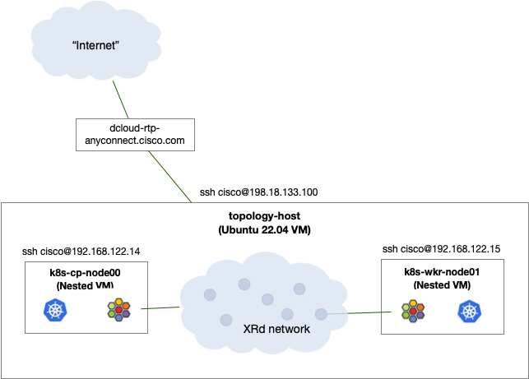
dCloud Lab Topology
Ubuntu 22.04 VM: topology-host
32 vCPU, 96GB memory
Access dCloud via AnyConnect VPN
Containerlab
Docker
XRd image(s)
Nested Virtualization: KVM
Prebuilt nested VM images
Build your own?
https://tbv3-ui.ciscodcloud.com/
https://wwwin-github.cisco.com/brmcdoug/cilium-srv6

Slide 11




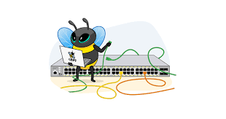


Containerlab
Open-source but heavily used (and maintained) by Nokia’s PLM and TMEs
Not just another GNS3, PacketTracer, Eve-NG (UnetLab for OGs), CML (VIRL), Boson NetSim (Real OGs)
Why do we need it ? Do we want to re-invent the wheel again. ?
Containerlab is a CLI (YAML) based container orchestrator that will create your networking labs and topology, and everything needed:
Topology Images (docker images)
Topology Link (docker networking !)
Support Container based Network Operating System (cNOS):
Cisco XRd
Sonic
Cumulus CX
Arista cEOS
Support Virtual Machine based Network Operating System (vNOS):
Cisco IOS XRv9k – Nexus 9kv – Cisco C8000v – Cisco C9000v
Juniper vMX …
Palo Alto PAN
Checkpoint
Fortinet
Perfect to learn Docker networking
Perfect to learn Linux and Linux networking
Perfect to learn YAML – JSON
Perfect to learn open source (contribute?)
Perfect to learn Isovalent/Cilium
Perfect to know how your competition software/Hardware behave (keep your friends close, keep your competition closer)
Perfect to Learn CI/CD – DevOPS (K8s) – Infrastructure as code
Perfect to learn Wireshark

Slide 12
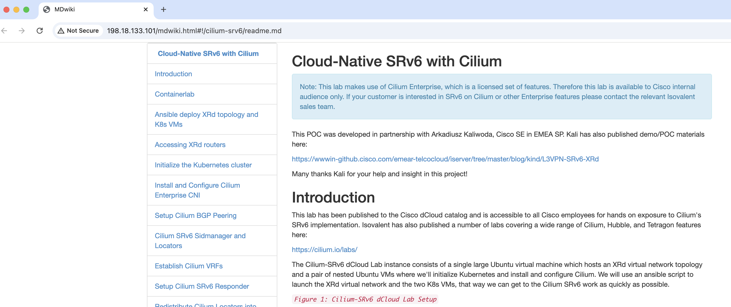
Alternate Lab Guide Once Connected to VPN

Slide 13
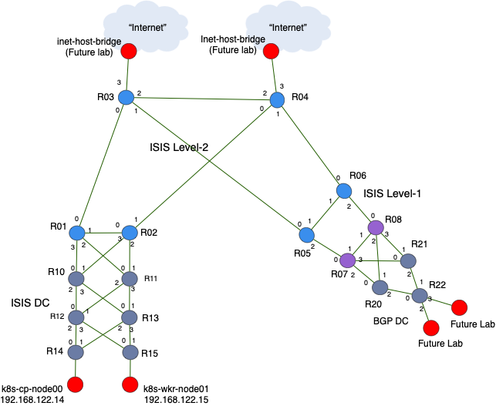
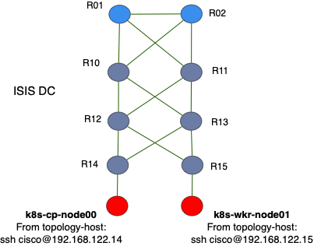
Virtual Network Topology
Topology designed to accommodate expansion and more use cases in the future
Today’s Lab will focus here
BGP Sessions:

Slide 14
Intro: Cilium and eBPF
Lab 1 – dCloud, Containerlab, XRd, Ansible
Lab 2 – K8s Fundamentals, Deploy K8s Cluster
Lab 3 – Cilium SRv6 L3VPN
Lab 4 – ISIS Redistribution into the Core
Conclusion: eBPF on Everything – IoeBPFT

Slide 15
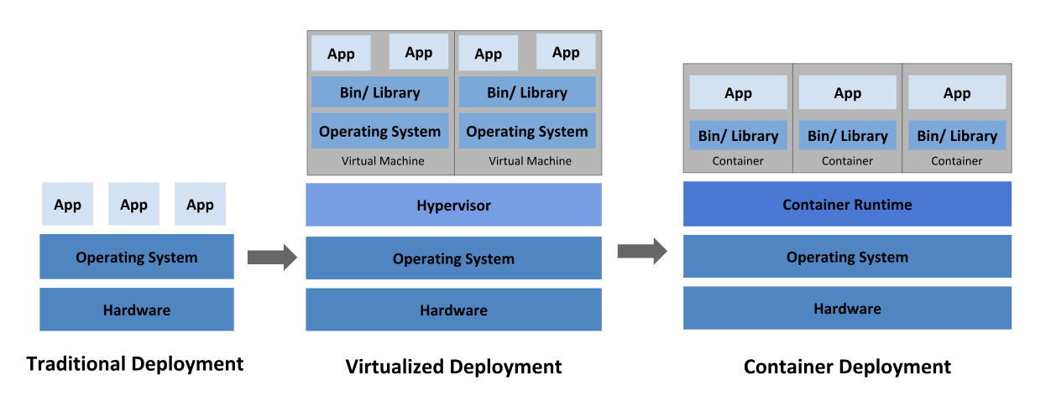
Kubernetes in One Two Slides!
https://kubernetes.io/

Slide 16
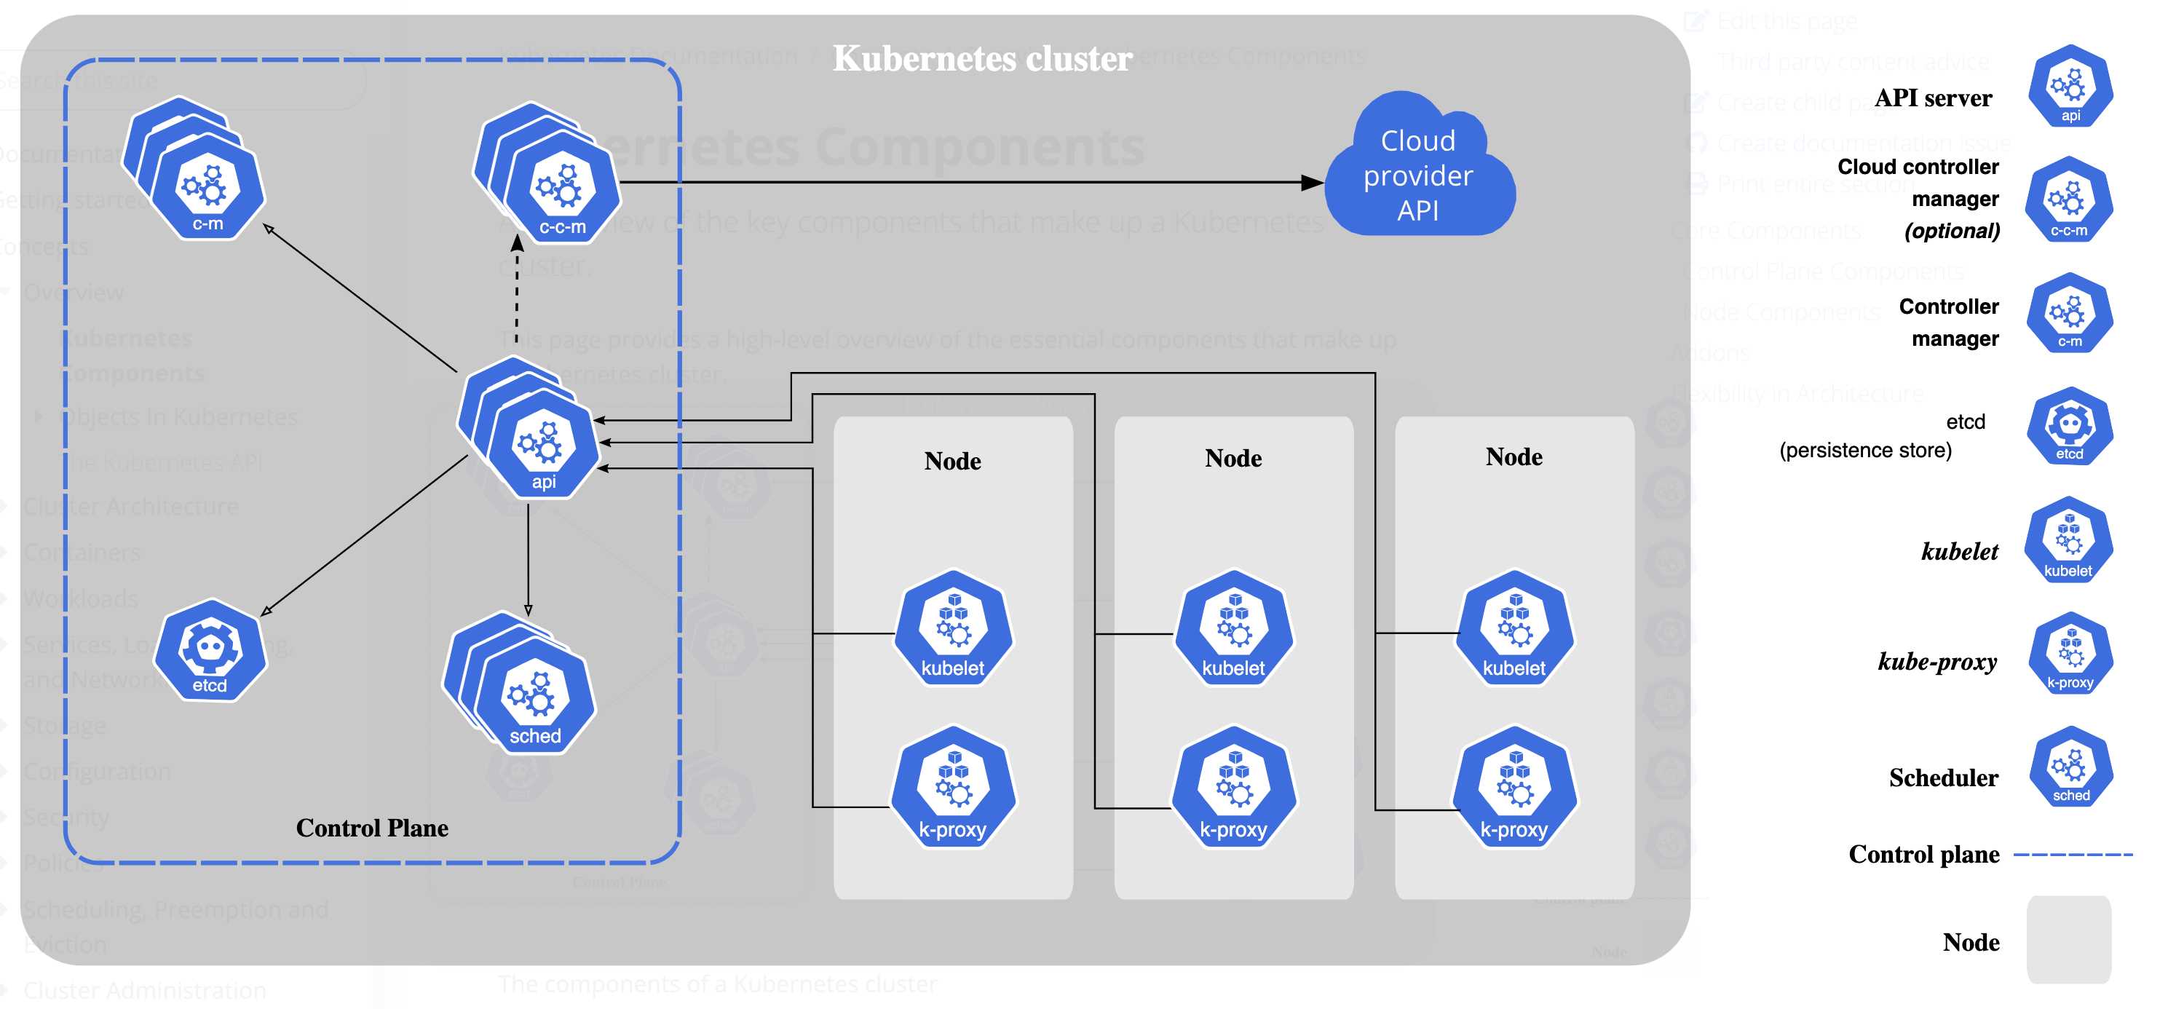
Kubernetes in One Two Slides!
https://kubernetes.io/docs/concepts/overview/components/

Slide 17
Two Node Kubernetes Cluster
We’ll use Kubeadm to initialize K8s Control Plane Node and Worker Node on our two nested VMs

Slide 18
Intro: Cilium and eBPF
Lab 1 – dCloud, Containerlab, XRd, Ansible
Lab 2 – K8s Fundamentals, Deploy K8s Cluster
Lab 3 – Cilium SRv6 L3VPN
BGP Peering
SRv6 SID-Manager; Locator Pool
Pods in VRFs
SRv6 Responder
Lab 4 – ISIS Redistribution into the Core
Conclusion: eBPF on Everything – IoeBPFT

Slide 19
Cilium/eBPF and SRv6
Bell Canada driving development
Working with AWS and GCP
Cloud-Native SRv6-L3VPN Attachment via Cilium CNI
Just the tip of the iceberg…
Dan Bernier presented at Kubecon EU 2024
https://www.youtube.com/watch?v=vJaOKGWiyvU&t=24s

Slide 20
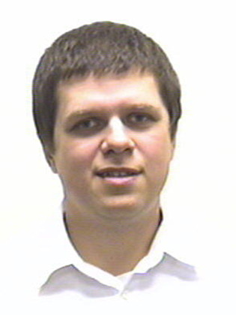
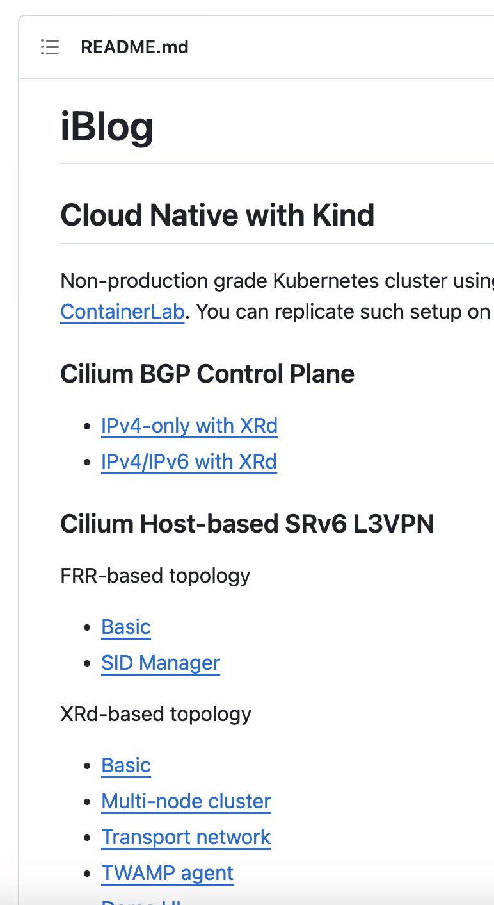
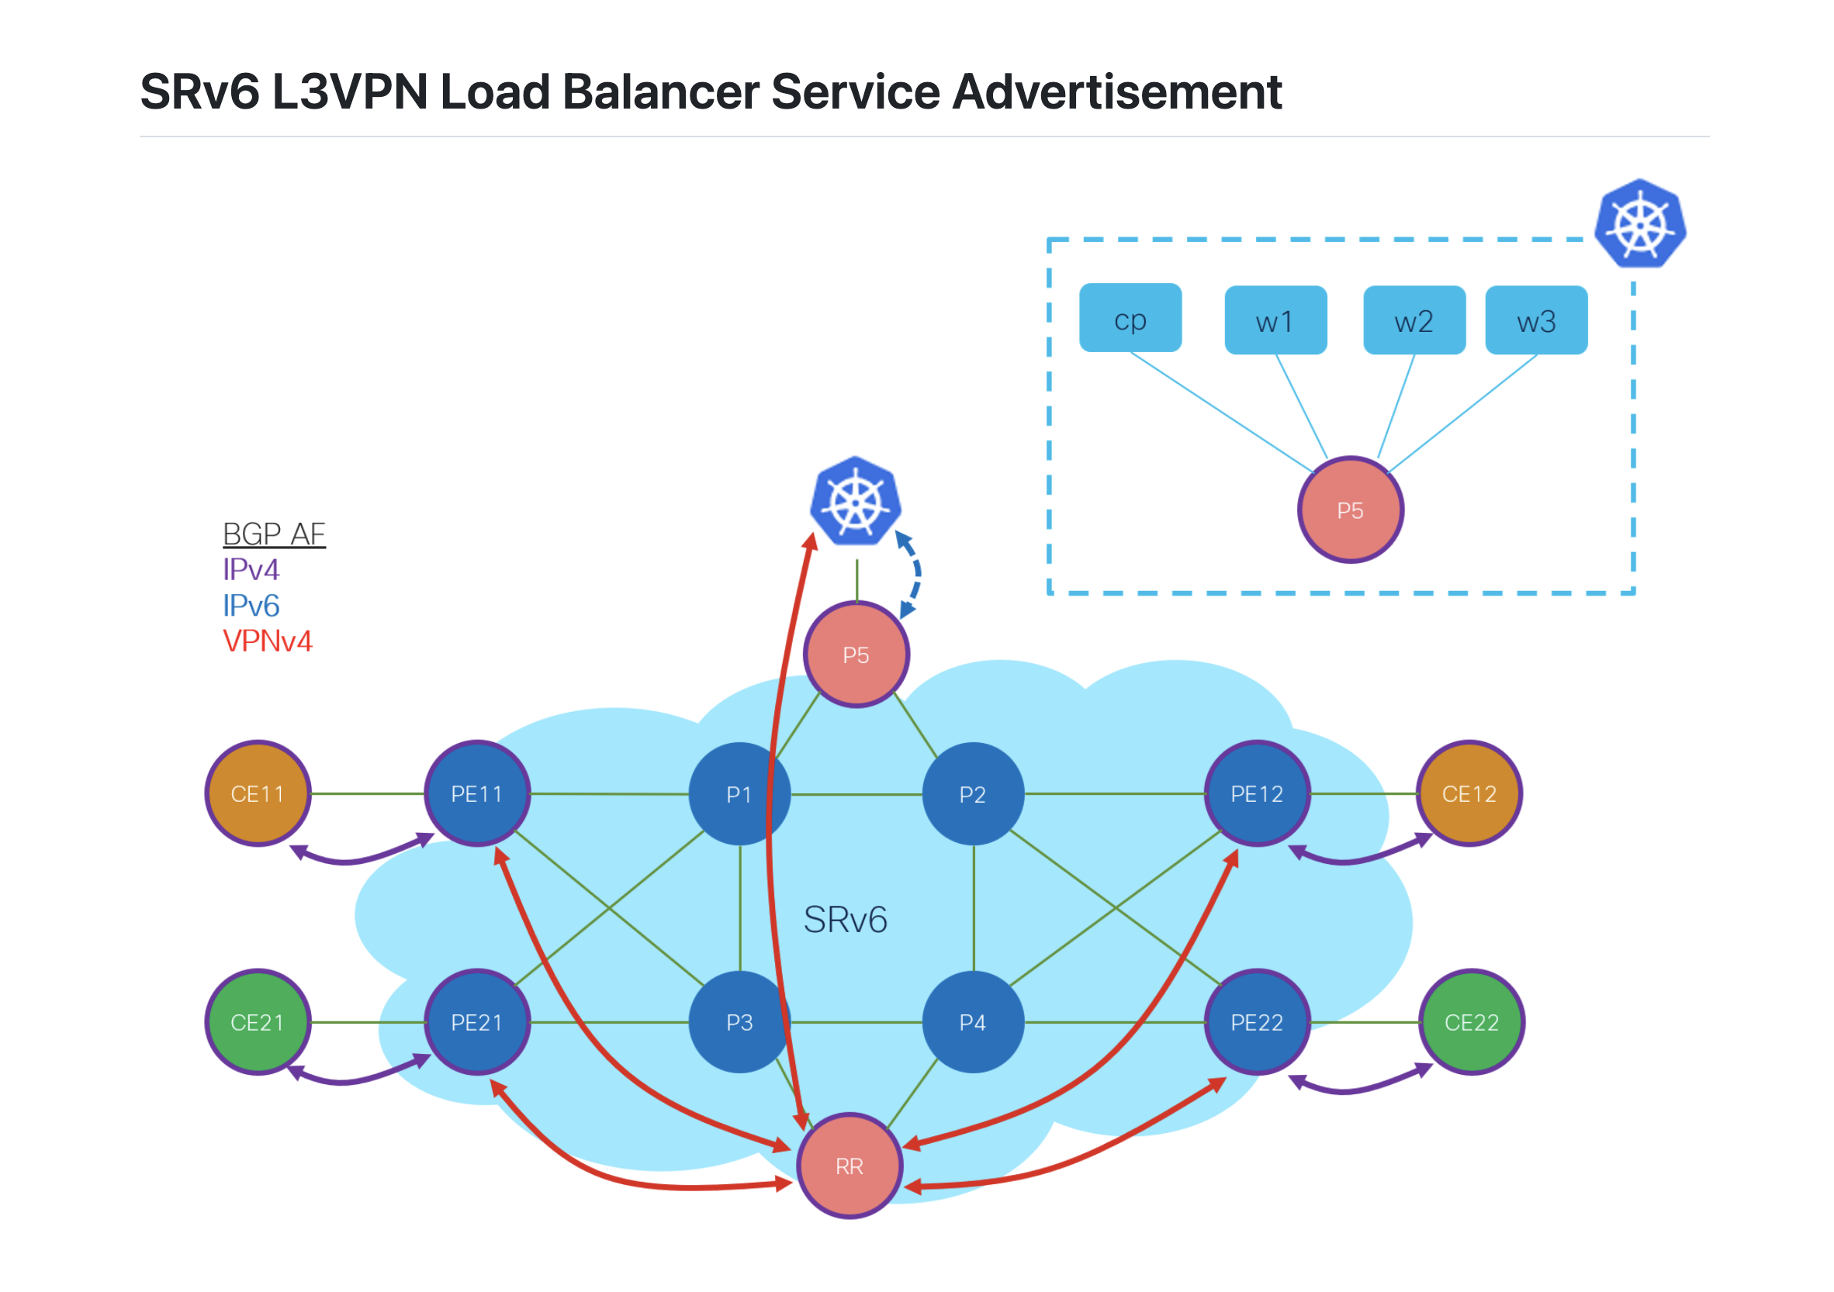
More Cilium SRv6 L3VPN
Arkadiusz Kaliwoda
https://wwwin-github.cisco.com/emear-telcocloud/iblog

Slide 21
Cilium SRv6 CRDs
Kubernetes Custom Resource Definions
Rest of the Network
BGP CRD
IPv4, IPv6, and “mpls_vpn” AFI/SAFIs
SRv6 SID Manager
Dynamic allocation of /48 or /64 locator from LocatorPool
K8s VRFs
Pods in VRF Blue and VRF Red
SRv6 Responder
SRv6 EgressPolicy programing for eBPF
Essentially the SRv6-L3VPN FIB entries
R14
BGP 65010
R15
K8s-cp-node00
ASN 65015
SRv6 Locator fc00:0:abc::/48
K8s-wkr-node01
ASN 65014
SRv6 Locator fc00:0:xyz::/48

Slide 22
Intro: Cilium and eBPF
Lab 1 – dCloud, Containerlab, XRd, Ansible
Lab 2 – K8s Fundamentals, Deploy K8s Cluster
Lab 3 – Cilium SRv6 L3VPN
Lab 4 – ISIS Redistribution into the Core
Conclusion: eBPF on Everything – IoeBPFT

Slide 23
Redistribute Cilium Locators into DC ISIS
Topology designed to accommodate future expansion and use cases
BGP Session:
Redistribute Locator /48s into ISIS

Slide 24
Intro: Cilium and eBPF
Lab 1 – dCloud, Containerlab, XRd, Ansible
Lab 2 – K8s Fundamentals, Deploy K8s Cluster
Lab 3 – Cilium SRv6 L3VPN
Lab 4 – ISIS Redistribution into the Core
Conclusion: eBPF on Everything – IoeBPFT

Slide 25
Cisco’s Air-Gap Network
Cisco’s Network
App
NIC
Servers hosting applications/workloads

Slide 26




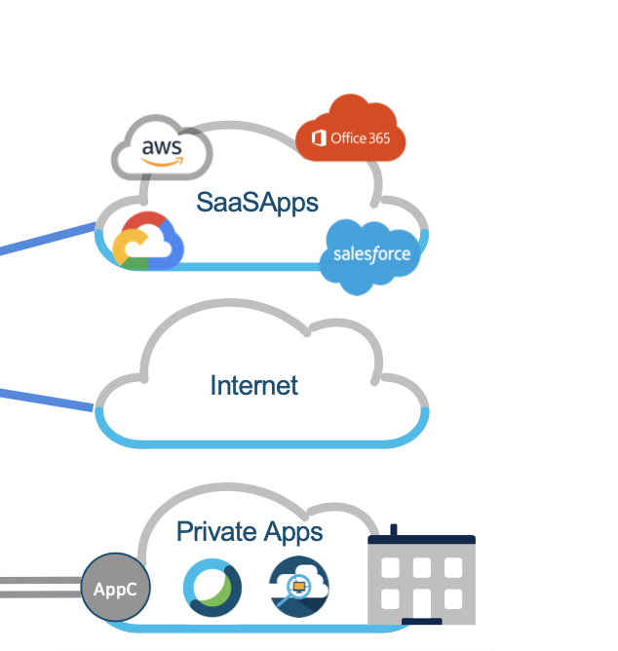
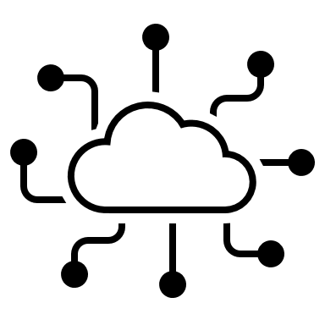
eBPF on Everything!
Universal policy execution engine and visibility agent for everything…in the galaxy
Policy Plane Control Elements
Policy Programming
Public Cloud
SP last mile, metro, or enterprise transport network
Transport network
Policy Execution Data Plane Elements
See also: https://isovalent.com/blog/post/networking-and-ebpf-predictions-for-2024/

Slide 27
Cilium: A Universal SDN Policy Engine
Cilium + eBPF as a Universal SDN for Controlling and Executing Network Policy:
Security (all the firewalling, including L7 FW)
Load Balancing, Proxying, http/https/TLS ingress (no more F5)
Egress GW for cluster segments (VPC-style network gateways)
Service Mesh
BGP, SRv6, and SRv6-TE and Service Chaining…Someday
Encryption
TCP Optimization
Other workload traffic policy like QOS
And it “will be Applicable outside K8s, a distributed dataplane for the broader industry”
Policy Control Plane
Distributed Policy Execution
Data Planes

Slide 28
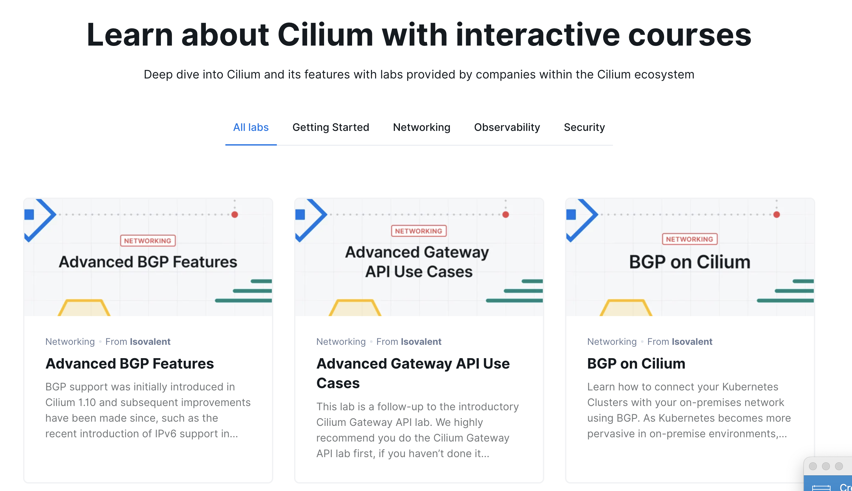
https://cilium.io/labs/

Slide 29
Resources, Links
Cilium get started
https://cilium.io/get-started/
eBPF
https://ebpf.io/
eBPF Documentary
https://www.youtube.com/watch?v=Wb_vD3XZYOA
Cilium/K8s networking eBook
https://isovalent.com/blog/post/introducing-the-new-kubernetes-networking-and-cilium-for-the-network-engineer-ebook/
Isovalent Labs
https://isovalent.com/resource-library/labs/
Swag!
https://cilium.myspreadshop.com/all
Source for this lab
https://wwwin-github.cisco.com/brmcdoug/cilium-srv6
A whole load of reference SRv6 labs
https://github.com/segmentrouting/srv6-labs

Slide 30
Thank you

